Slide 1
Unit 1-4 Measuring Angles
PLANE Geometry

Slide 2
Angle:
2 Rays with a Common Endpoint
Rays Meet at the Vertex
A
1
B
C

Slide 3
Example 1
Name the angles.
N
•
4
•
3
T
•
•
A
P

Slide 4
Types of Angles
ACUTE
Less Than 90°
RIGHT
90°
OBTUSE
Greater Than 90° Less Than 180°
STRAIGHT
180°

Slide 5
Congruent Angles:
Angles That Have the Same Measure
$$30°$$
$$30°$$
A
B
$$∠A≅∠B$$

Slide 6
Angle Addition Postulate:
D is the interior of $∠ABC$ if and only if
$$m∠ABD+m∠DBC=m∠ABC$$
D
•
•
C
•
•
B
A

Slide 7
Example 2
Find the measure of the given angle.
N
•
A
●
T
●
97$°$
•
27$°$
T
$$36°$$
86$°$
•
●
●
A
O
•
C
P
$$m∠AOC=$$
$$m∠PAT=$$

Slide 8
Example 3
78$°$
B
●
A
●
T
●
41$°$
140°
●
●
●
$$x$$
●
A
O
C
●
O
C
$$x=$$
$$m∠BOC=$$

Slide 9
Example 4
m∠DEF = 128°
D
●
(6x+5)
(2x+3)
●
●
E
F

Slide 10
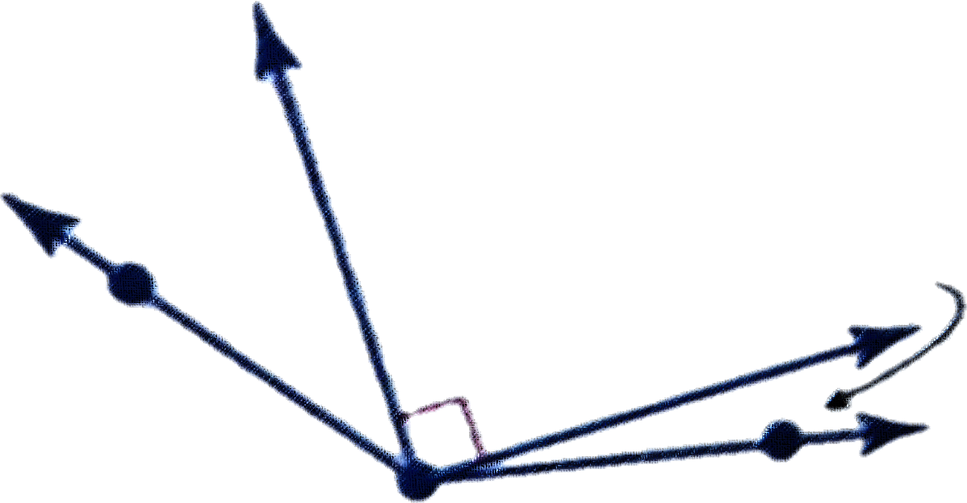
Example 5
Find $m∠3$ if $m∠1=23°$ and $m∠ABC=131°$.
A
1
2
3
B
C

